Slide 1
NBA: Does Age Affect Salary?
By: Grrish Magan

Slide 2
Why did you choose this dataset? What interested you about it, and what questions did you hope to explore?
Origin
I chose to this data set because I have been an NBA fan since I was very young and still am a fan to this day!
The Big Question.
Does age affect the salary of an NBA player?
This data set had previously been used during my Intro Data Science with Python class, and I have wanted to answer my own questions using it.

Slide 3
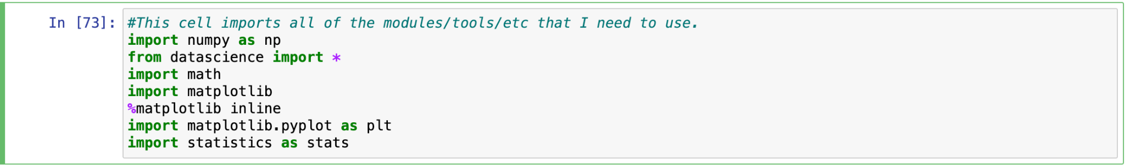
Step 1: Setting up the Environment
1

Slide 4
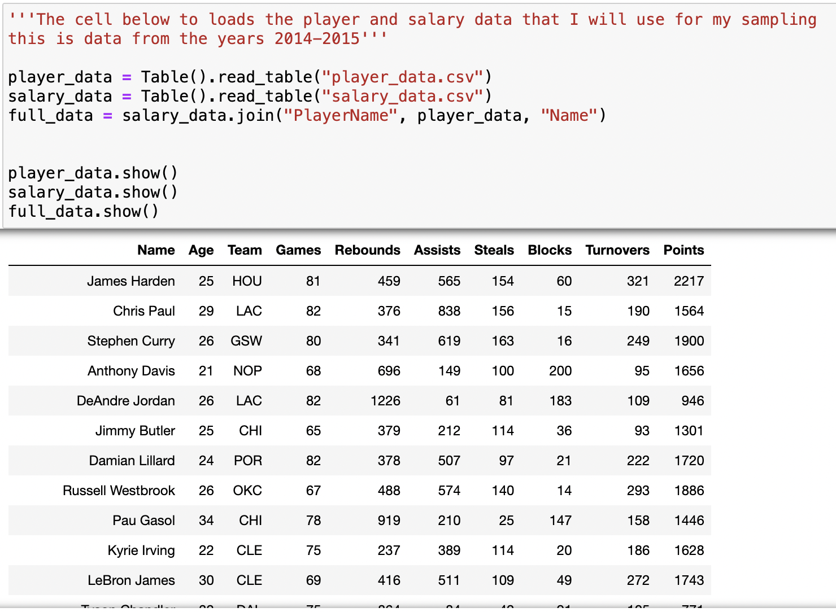
Step 2: Setting up the Data
2

Slide 5
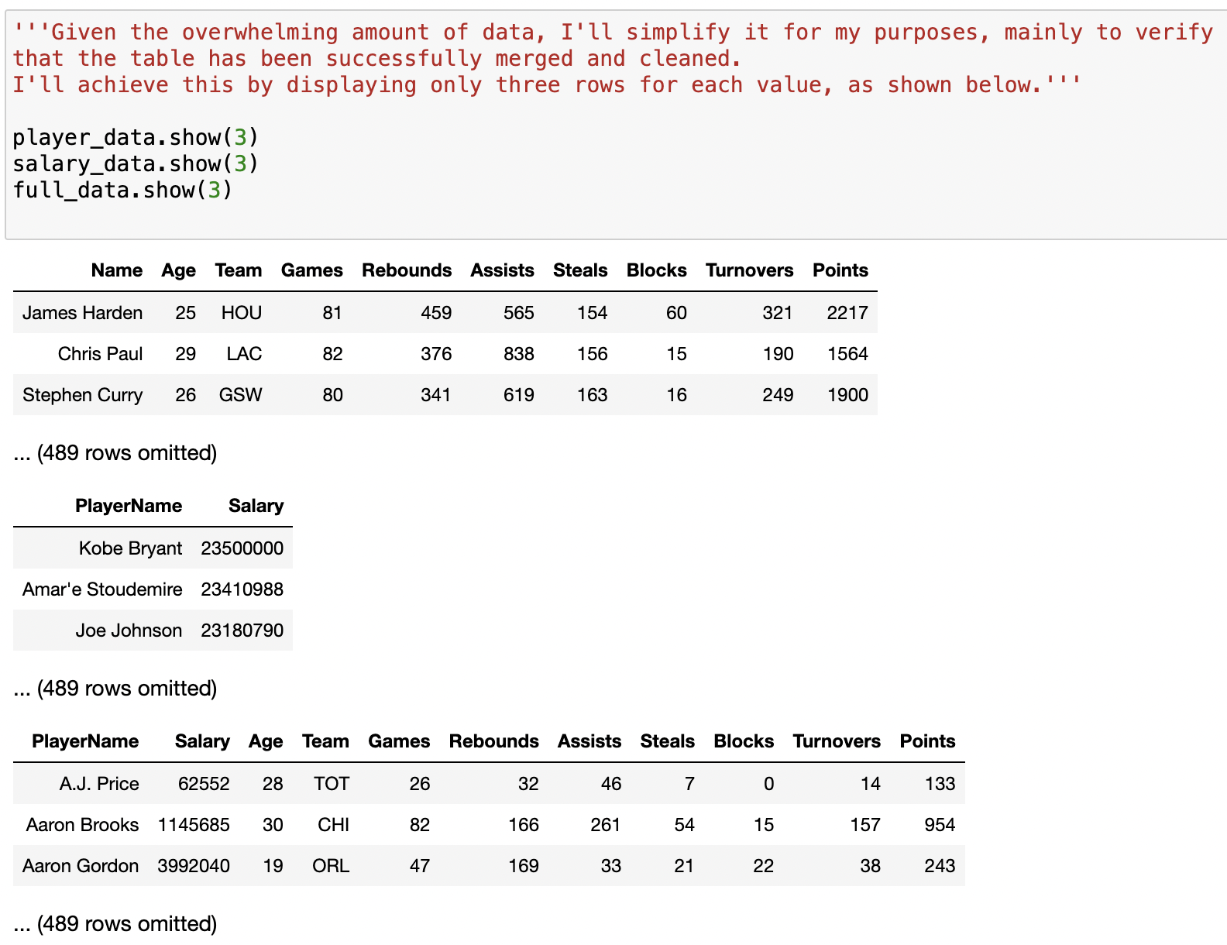
Step 3: Cleaning the Data
3

Slide 6
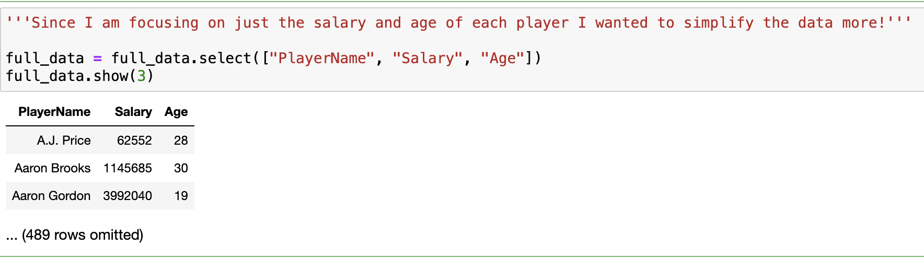
Step 3: Cleaning the Data cont.
3

Slide 7
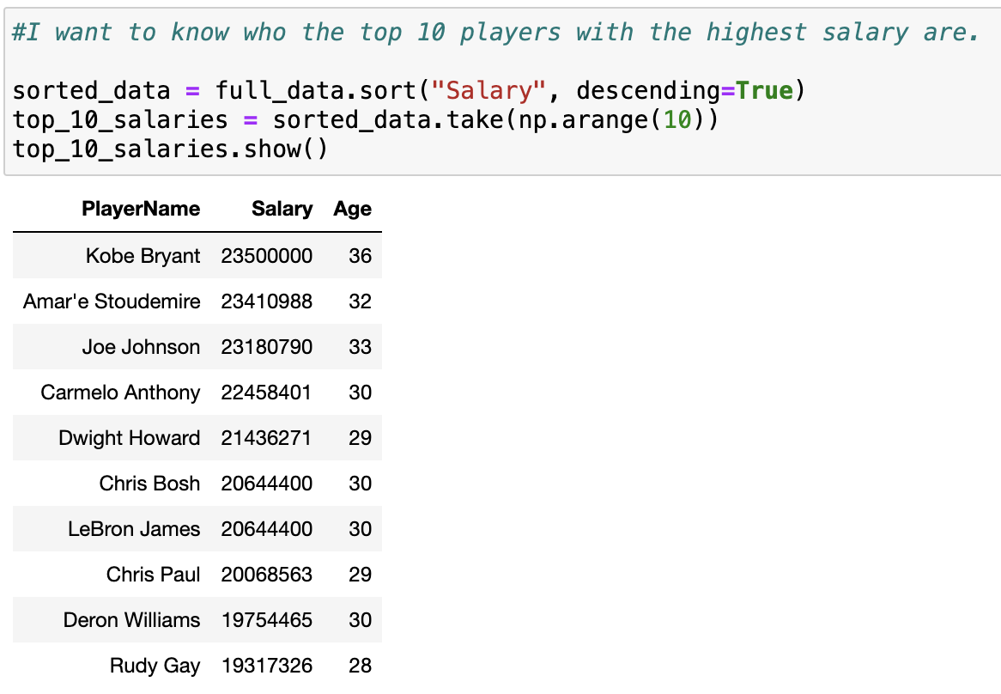
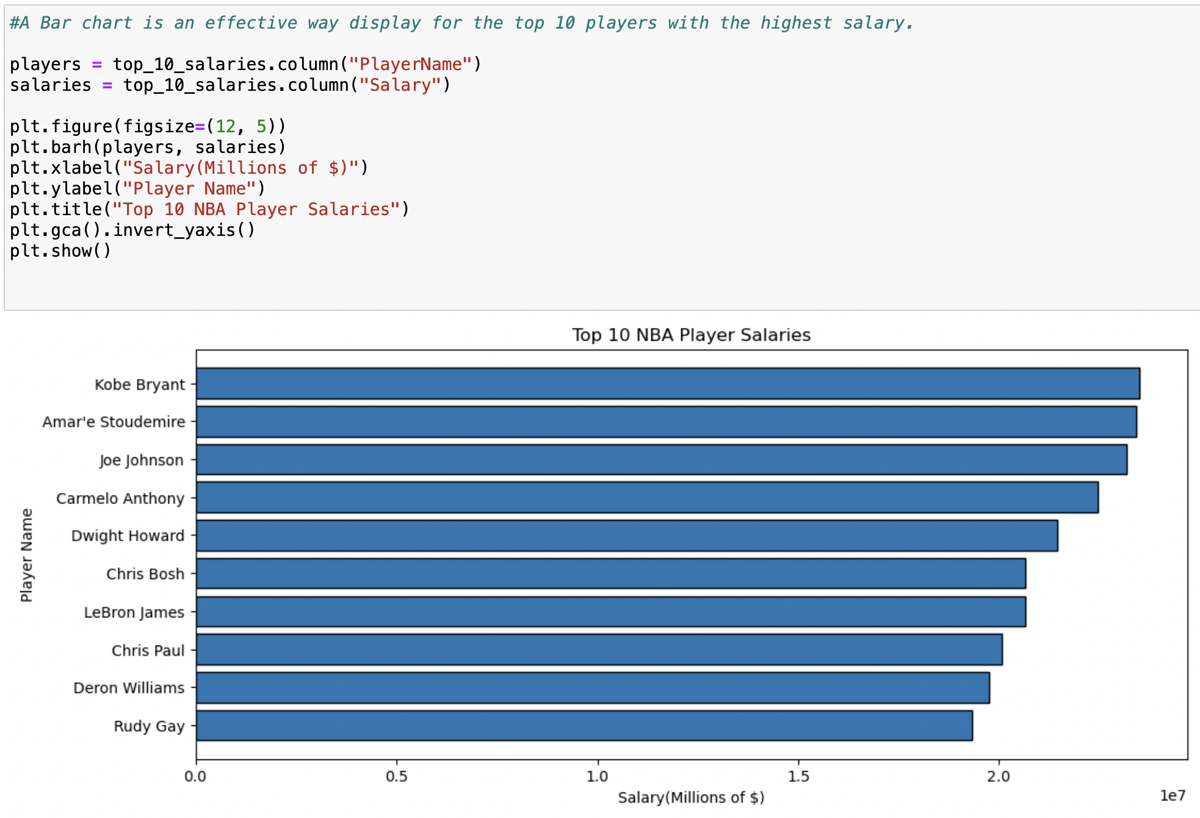
Step 4: Top 10 Player Salaries
4

Slide 8
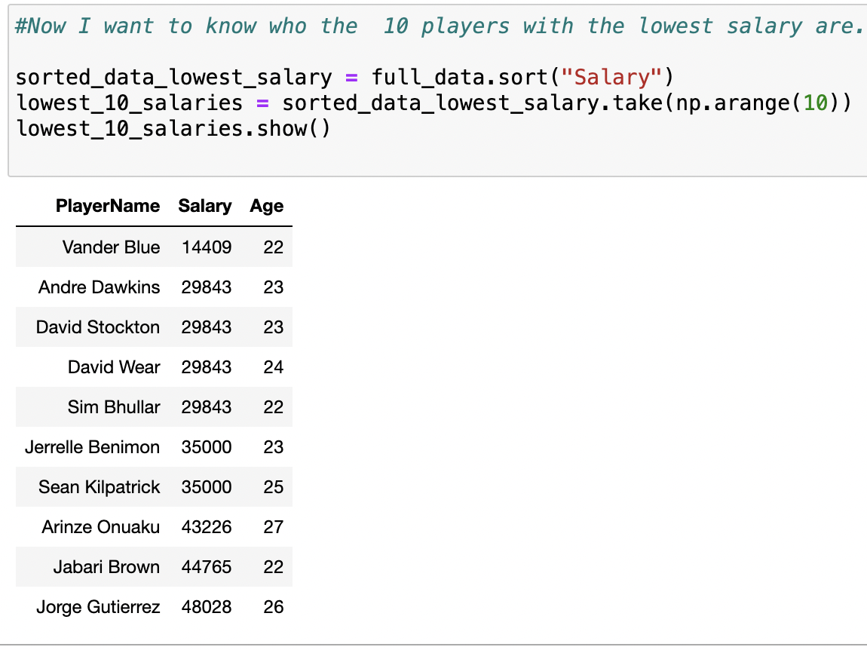
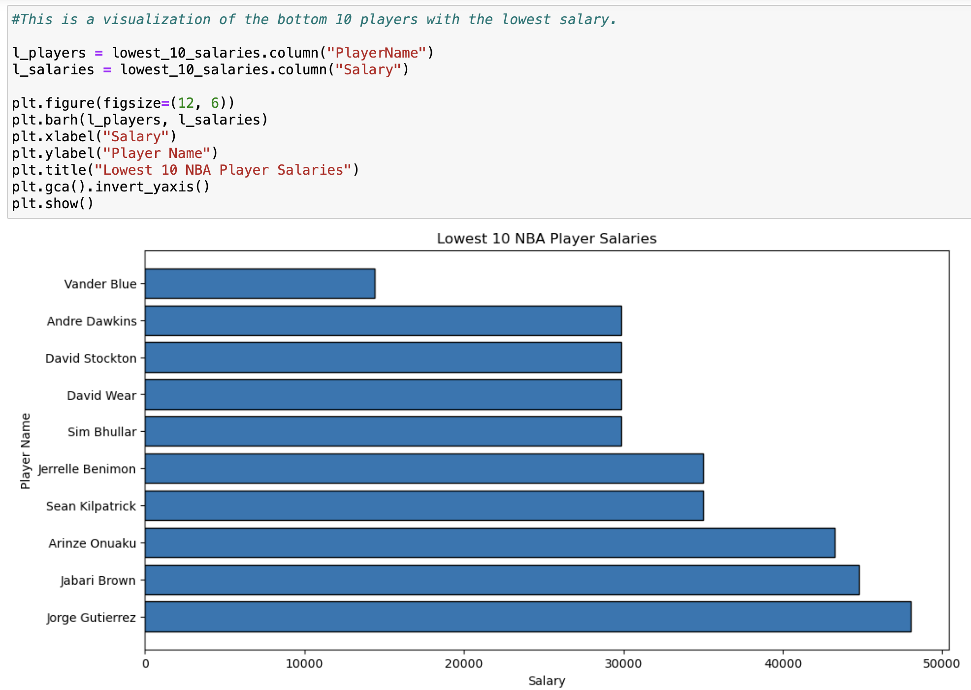
Step 5: Bottom 10 Player Salaries
5

Slide 9
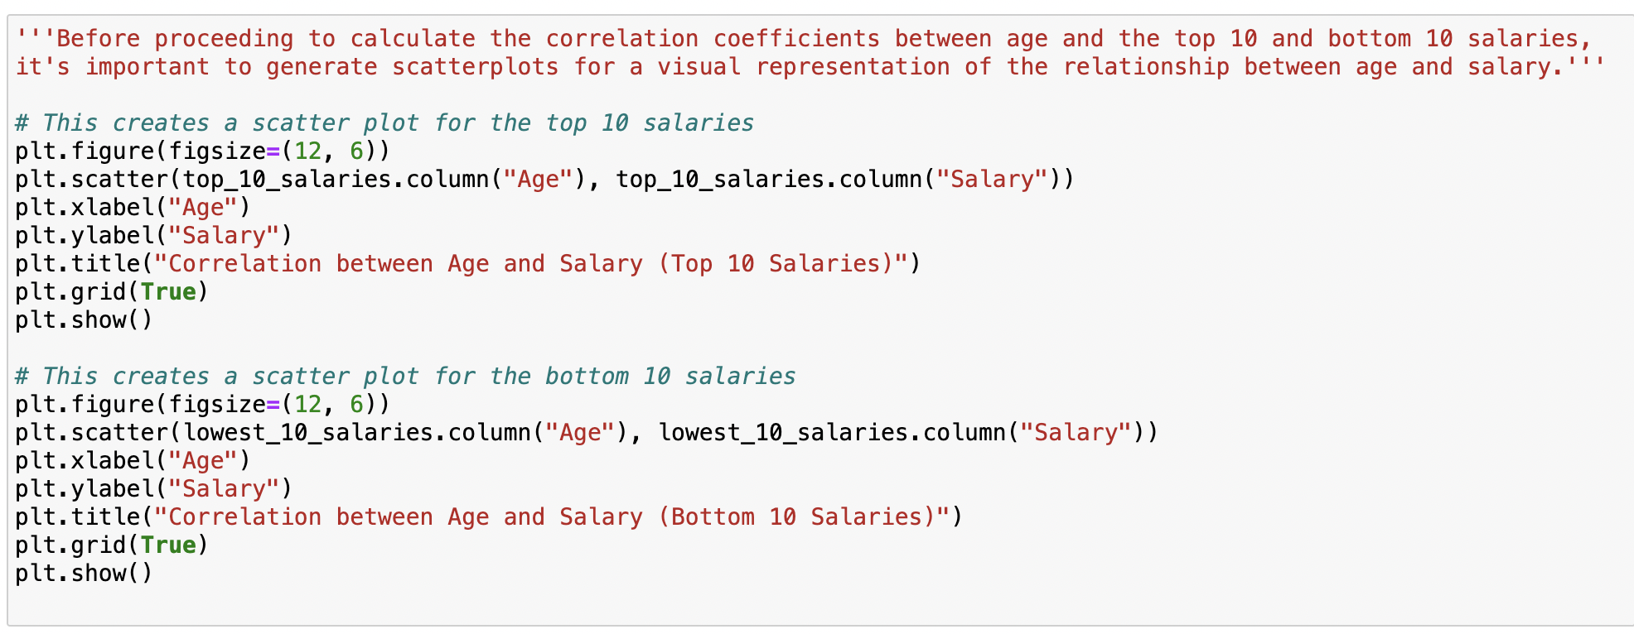
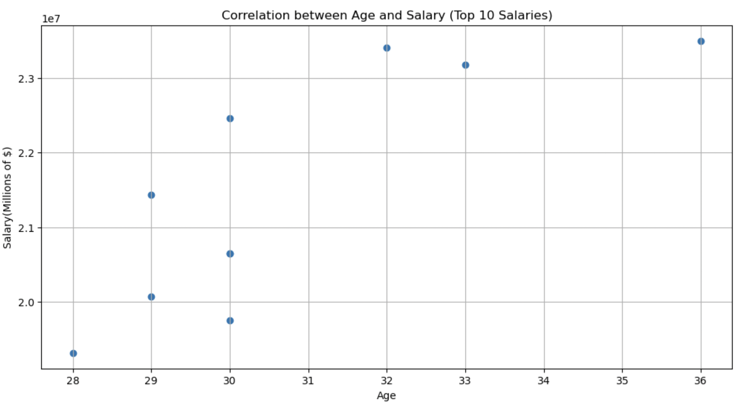
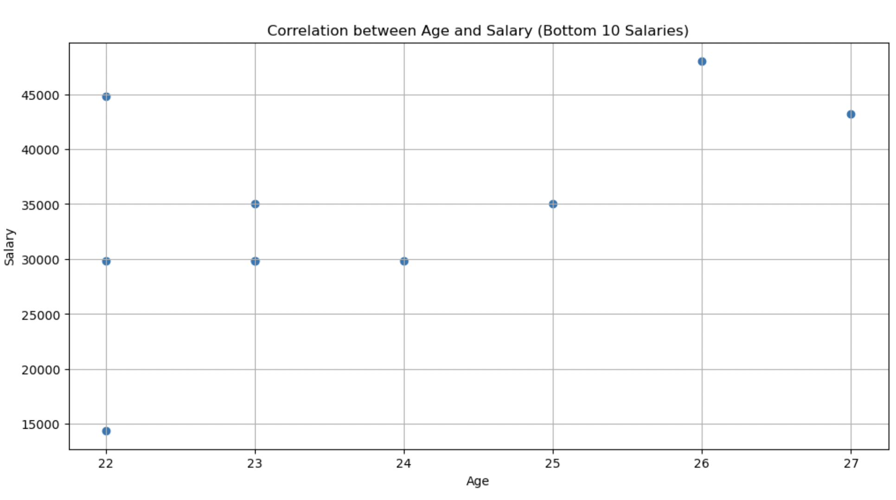
Step 6: Visualizing the Top & Bottom 10 Salaries
6

Slide 10
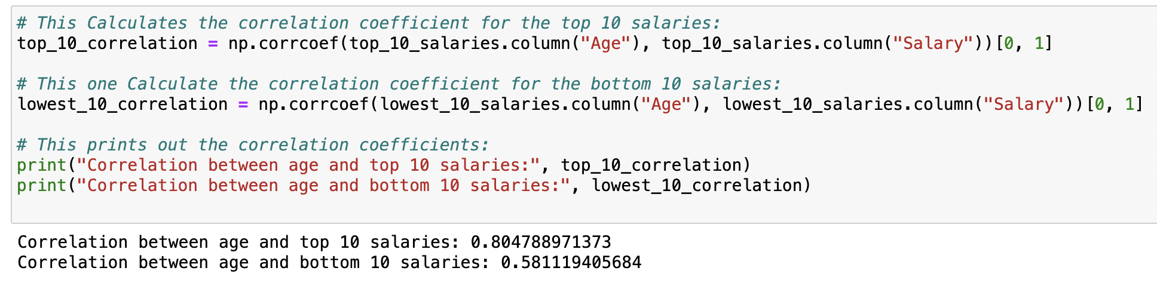
Step 7: Calculation of the Top & Bottom 10 Salaries
7
There is a much stronger positive correlation between the top 10 highest-salary NBA players (0.804788971373) and to the lowest 10 salary players (0.581119405684).
This means that among the top earners, there is a more noticeable and consistent trend where, as age increases, player salaries tend to increase significantly. On the other hand, among the lowest earners, the correlation is not as pronounced showing that the relationship is somewhat less predictable.

Slide 11
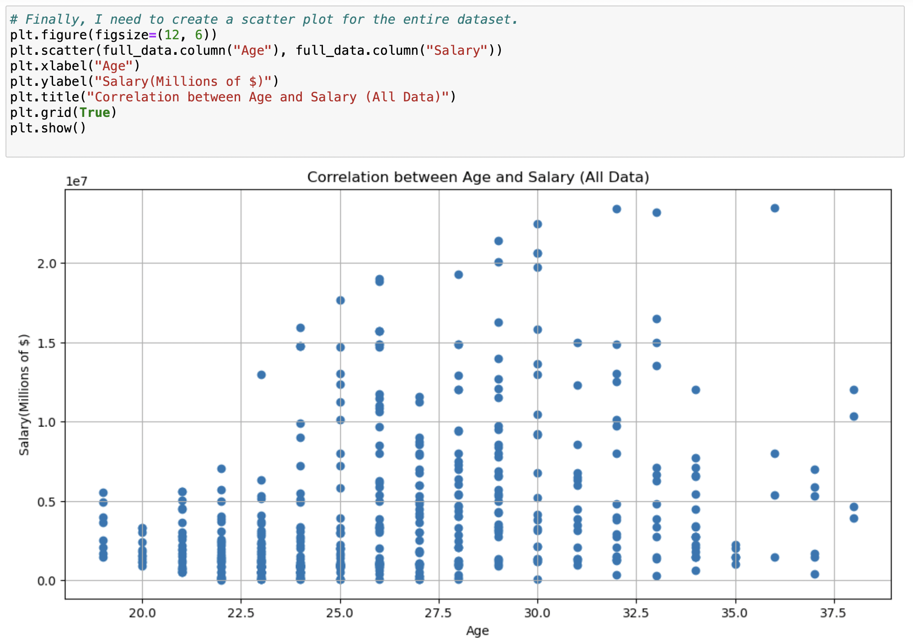
Step 8: Visualizing the Entire Dataset
8

Slide 12
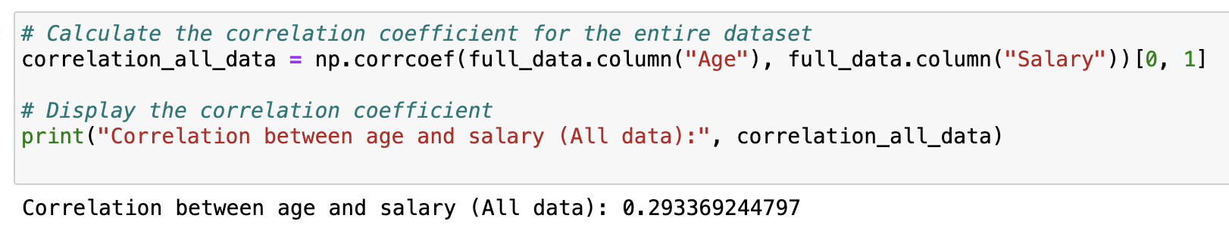
Step 9: Calculation of the Entire Dataset.
9

Slide 13
Results
The final correlation coefficient of 0.293369244797, indicates a weak positive correlation between age and salary for NBA players.
The positive correlation suggests that as the age of the NBA player increases, so does their salary.
The magnitude of the correlation is greater than 0 however it is not extremely close to 1. This indicates that even though there is a positive correlation, it is not very strong(the closer it is to 1 the stronger).
This tells me that although the older players do get paid more, there is a degree of variability in the data, and it's possible that other factors also contribute to player earnings, so other player statistics must be considered.

Slide 14
Reflection
Limitations | Trial & Error | Refinement
A limitation in my analysis was the presence of extreme outliers. Certain players had exceptionally high or low salaries, which highly influenced the correlation. Additionally, my analysis could identify a correlation between age and salary, but it can’t establish causation (can’t explain the underlying reasons for the observed relationship). | I went through a process of trial and error when creating my visualizations. It required numerous attempts and involved researching how to ensure that the axes, labels, and plot sizes appeared correctly and well-organized, avoiding clutter and confusion. | With more time and experience I would have included a linear regression line for the scatterplots, however I do not have the coding experience for it at the moment. I also would have conducted a hypothesis test, opting for a more sophisticated analysis than the basic one I performed. Additionally, I would have utilized an updated/larger dataset, incorporating current player data. (larger sample size = more accurate the results)

